Slide 1
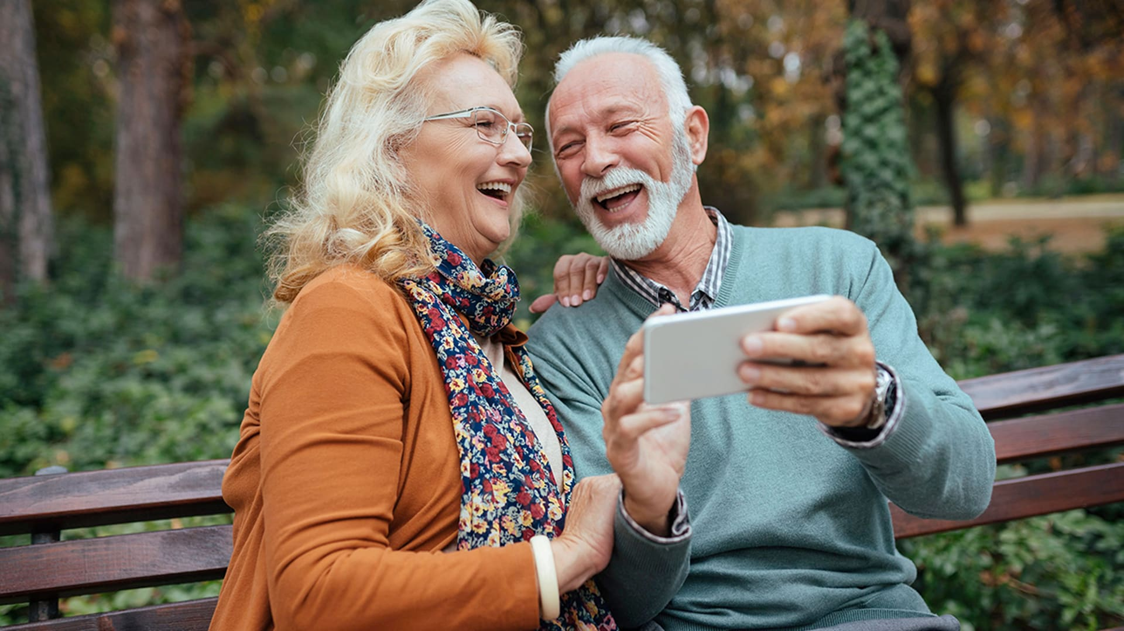

Building a Virtual Assistant for Trading APP Using Deep Learning and LLM for Seniors & People with Disabilities
Guruprasad
Velikadu Krishnamoorthy

Slide 2
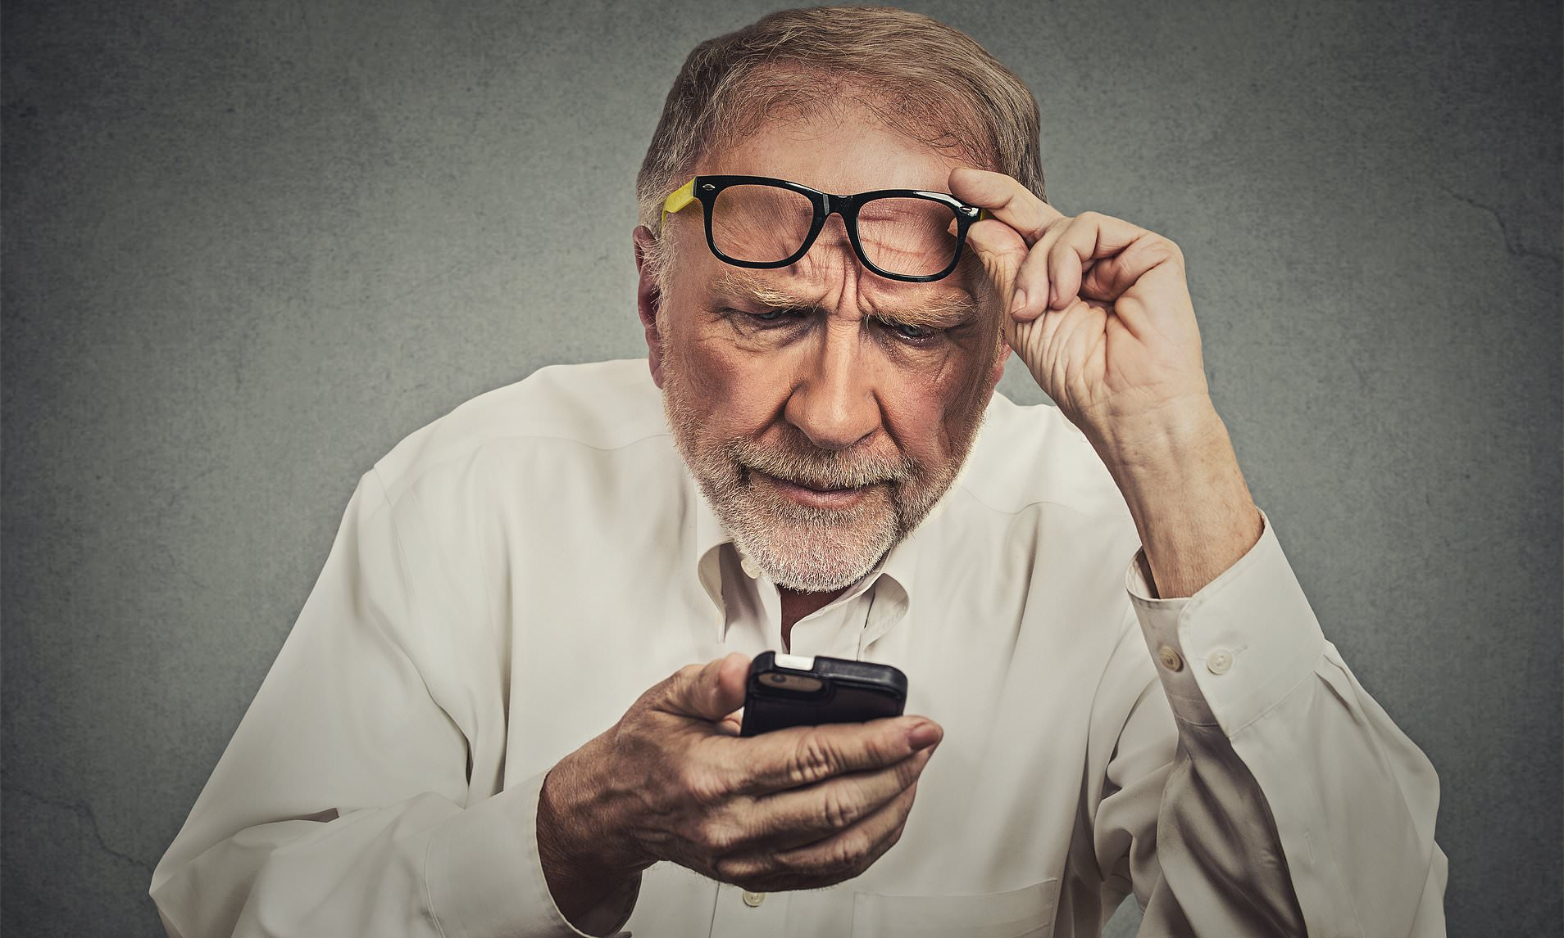
Problems faced by Seniors and People with Disabilities While using Trading Apps
Too much Technology:
Most older adults find the Technology and usage of cell phones to be overwhelming.
They are worried about tapping the wrong button, getting locked out, clicking an incorrect option, and losing all their money.
Remembering the Passwords is a struggle:
With almost every app on the phone requiring creating a user ID and password, maintaining too many credentials and remembering them can take time and effort.
Maintaining the same username and password across all accounts can be easily exploited if it gets into the wrong hands.
Many older adults don’t trust the Face ID, or they have difficulty setting it up.
People with Disabilities are also Struggling:
Though the screen reading options can help them navigate the options on the screen and the Braille keypad can help type on the screen, the whole experience can be very challenging.
Security can be another challenge. Face ID Biometric authentication may not be most effective for Blind and Visually impaired customers.

Slide 3
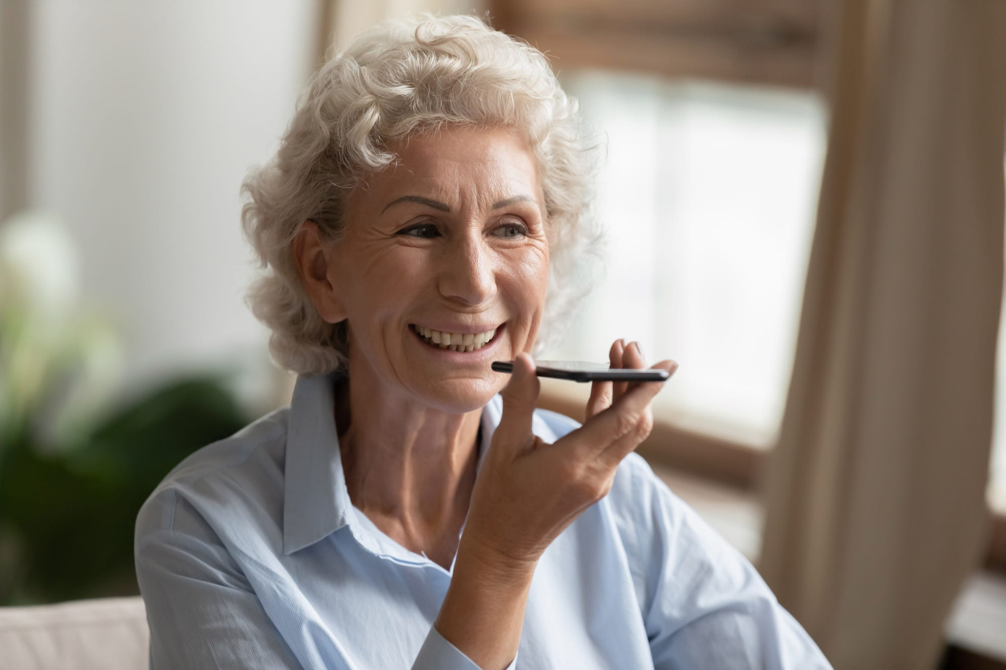
How can Machine Learning Help?
Problems faced by both sections of society are the same- easy & secure biometric authentication methods and the need for easy navigation.
Building Easy to use Authentication Methods:
Biometric authentication is implemented by using the customer’s voice as the password. When the customer calls the bank or opens the mobile app, they will be asked to repeat the numbers from 0 through 9.
By analyzing the voice commands using deep learning and Neural networks, the Model can identify if the real customer is trying to access them using Voice Identification.
The customer will also be asked to enter a Passphrase to provide another layer of Protection. They can either type or speak the passphrase.
Building a Virtual Assistant:
Once the customer is authenticated, they can interact with the virtual assistant, asking simple questions in English, such as "What is my current Balance?" or "What is the price of Apple Stock today?".
They can also choose to speak to the virtual assistant, thus removing the need to type anything on the screen.

Slide 4
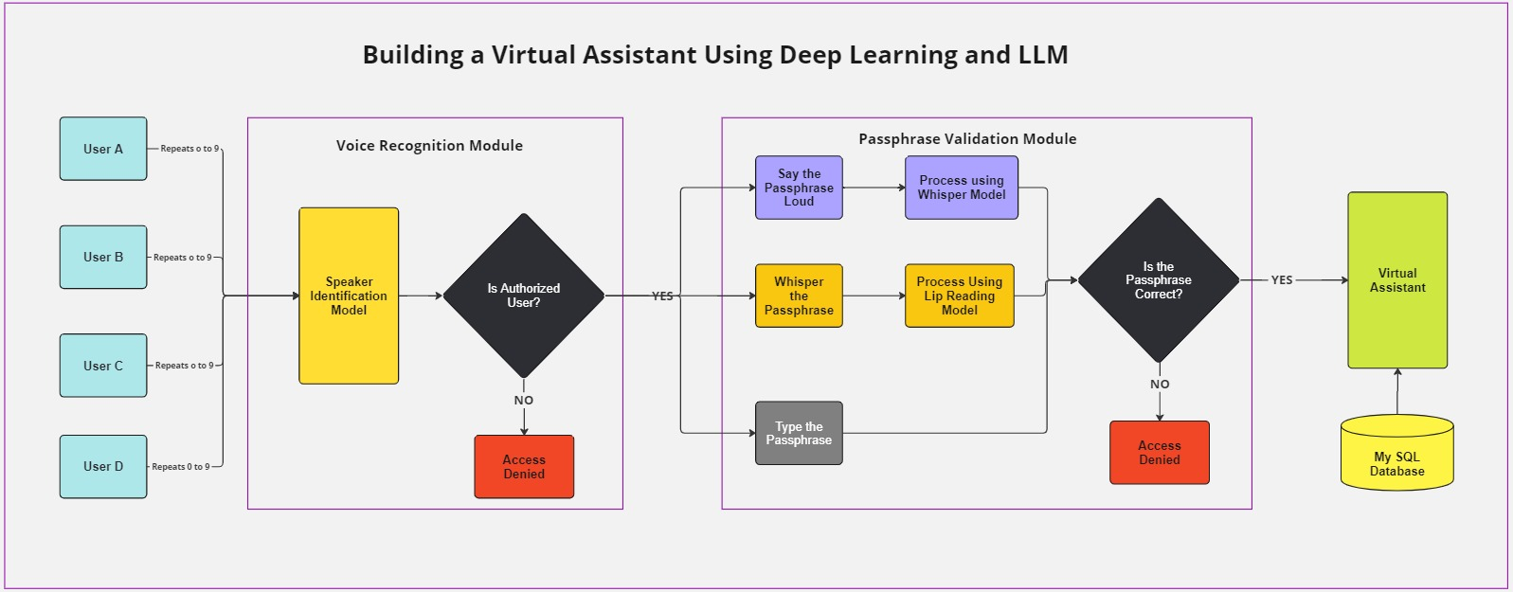
Architecture of the Model
As an account can have more one authorized user, the model can validate multiple voices per account. Voice recognition was implemented by using Speaker classification methods.
For Passphrase validation, Whisper Model was used to extract the text from Audio.
Lip reading was also implemented using Deep learning to recognize the passphrase.
Once the customer is successfully authenticated, they will be able to use the Virtual assistant asking questions about their portfolio using simple English phrases.

Slide 5
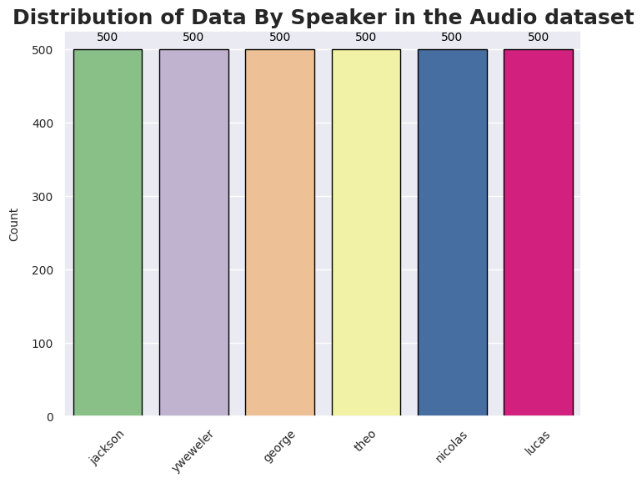
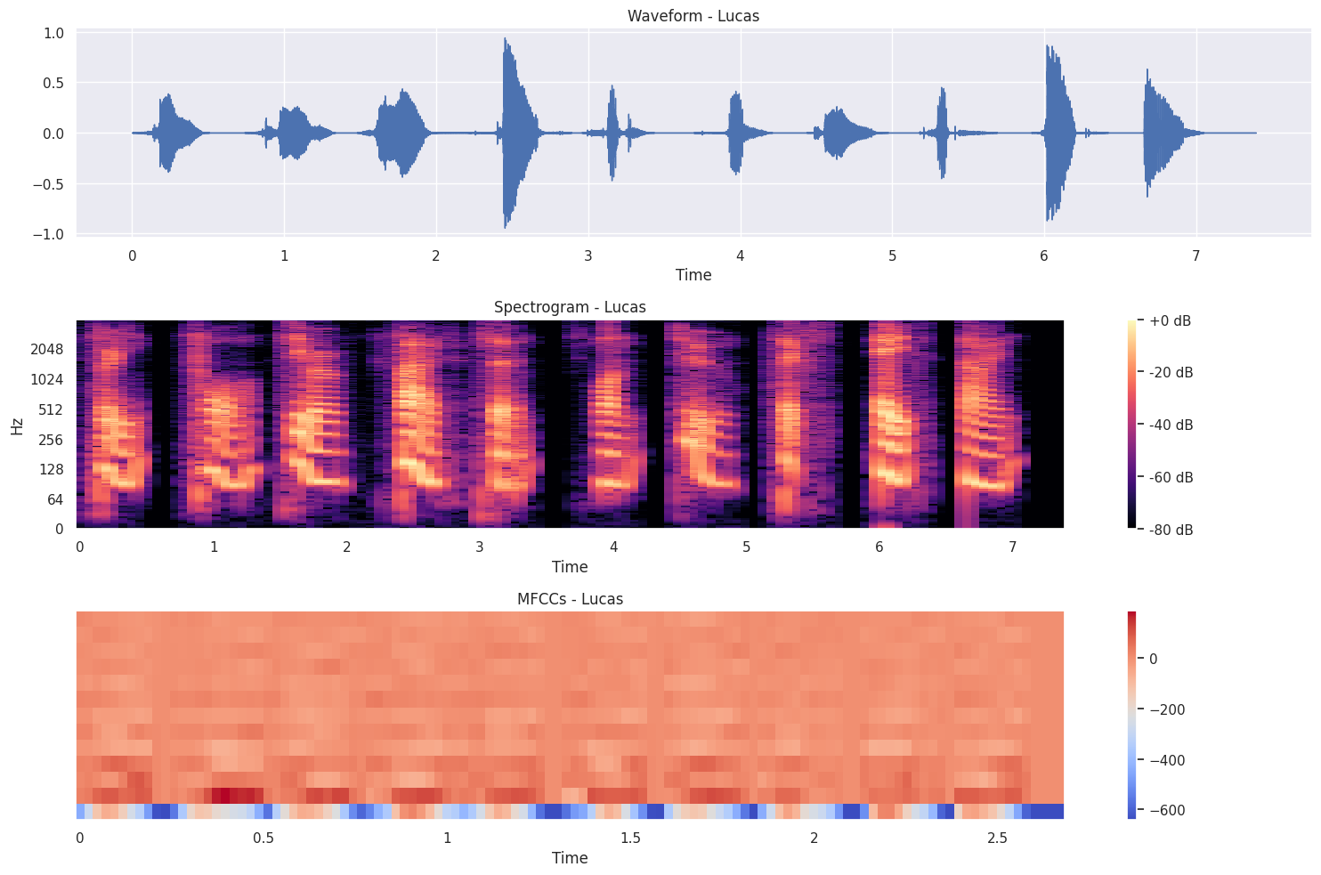
Voice Recognition Model
Data Exploration:
The data to build the Voice Recognition model was taken from the Free-spoken Digit dataset containing 3000 recordings by 6 actors speaking the digits from zero through Nine.
Data Preparation:
As the model requires the users to read the numbers from zero through Nine, the individual audio files were combined based on the speaker, and 300 files were created.
The combined audio files were converted into a NumPy array using the Librosa library in Python and various plots such as Wave Plot, Spectrogram, and MFCC (Mel Frequency Cepstral Coefficient) for each user were plotted.

Slide 6
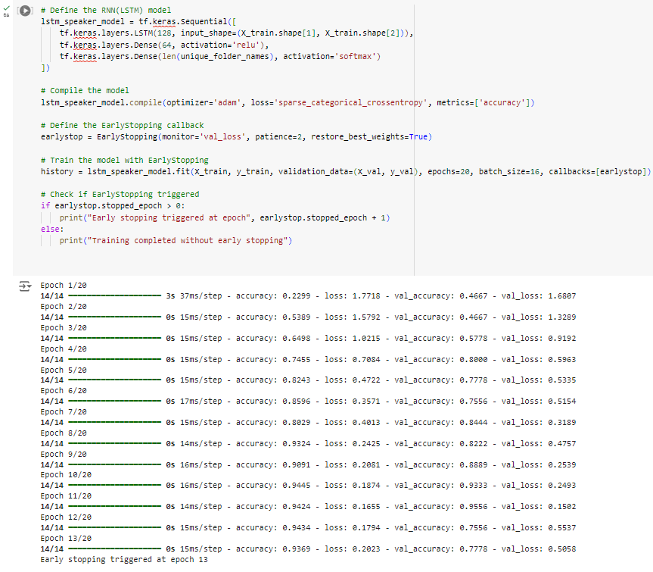
Voice Recognition- FEATURE Extraction & Model Building
Feature Extraction:
13 MFCC coefficients were extracted from the audio data, with each coefficient representing data such as spectral slope, shape of vocal tract, nasality of speech, etc.
The extracted features in NumPy array format were standardized and padded. The process was repeated for all 300 combined files.
Model Building:
The LSTM (Long Short-Term Memory) model, a Recurring Neural Network (RNN) model that works well with Sequential data, was used in this project.
The LSTM Layer with 128 neurons was used, while the “ReLU” (Rectified Linear Unit) was used as an activation function in the hidden layer with 64 neurons
The softmax function was used as an activation function ideal for multi-classification models in the final output or dense layer with as many units as the number of speakers. Also, early stopping was used to avoid overfitting, and the model was trained on 20 epochs using an "Adam" optimizer for compilation.
The Sparse Categorical Cross Entropy was used as a Loss function, which is used when the target class is represented as an integer class instead of a one-hot encoded variable.

Slide 7
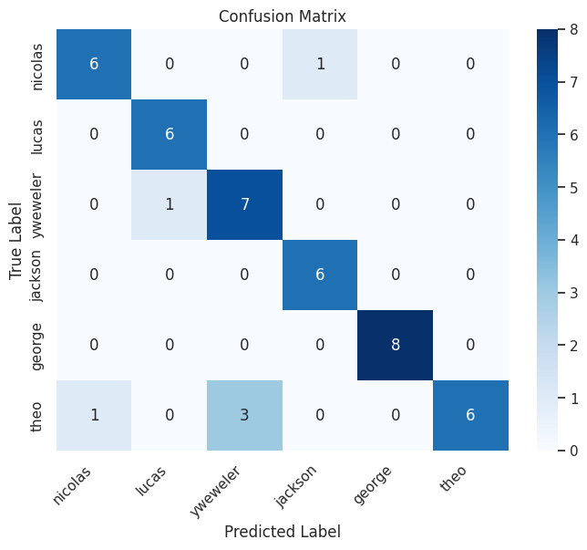
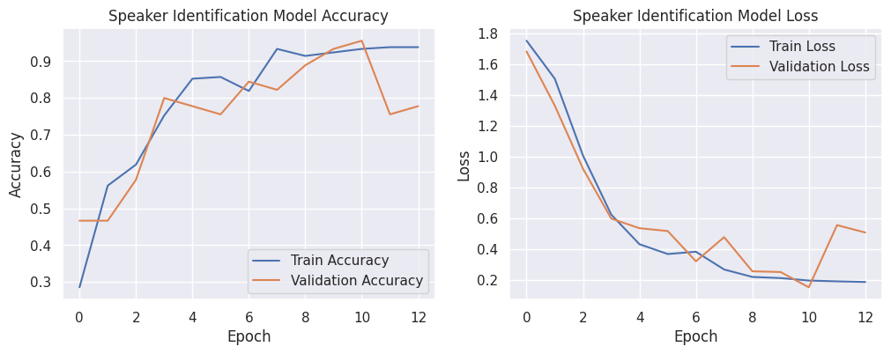
Voice Recognition- Model Evaluation
The Voice Recognition model was evaluated by plotting the Loss, Accuracy, and Confusion Matrix. Accuracy represents the percentage of predictions where the predicted value is the same as the actual value
From the plot, the Accuracy appears to increase as the number of Epochs increases, while the Loss, which represents the sum of errors made in each sample, decreases as the number of epochs increases.
The Confusion Matrix, commonly used to describe the Classification model performance, suggests that the Model predicted most values correctly.
The test evaluation accuracy of the model was 86%, indicating the model could predict most values correctly.

Slide 8
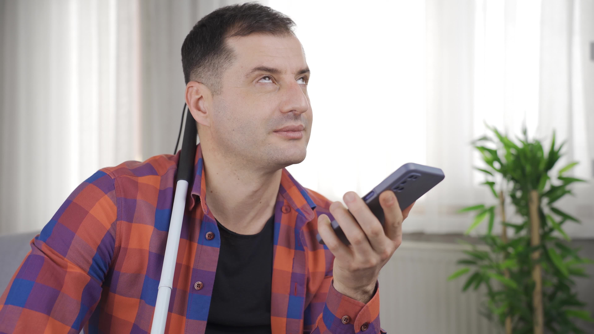
Passphrase Identification- Models
To provide a second layer of Protection, the customer would be prompted to enter or say the passphrase to access the account. Two models as described below were built to implement this:
Whisper Model:
If the customer chooses to say the passphrase, the Whisper Model from OpenAI will be invoked to convert the Speech to text and validate the Passphrase.
Lip Reading Model using Deep Learning:
If the customer feels uncomfortable saying it out loud, they can also choose to whisper the passphrase. Lip reading using deep learning was used to analyze the lip movements and identify the passphrase.
The dataset used for lipreading was taken from the GRID audiovisual sentence corpus. The dataset includes 1000 videos, each lasting a few seconds long speaking a set of words that are also included in the alignment file.

Slide 9
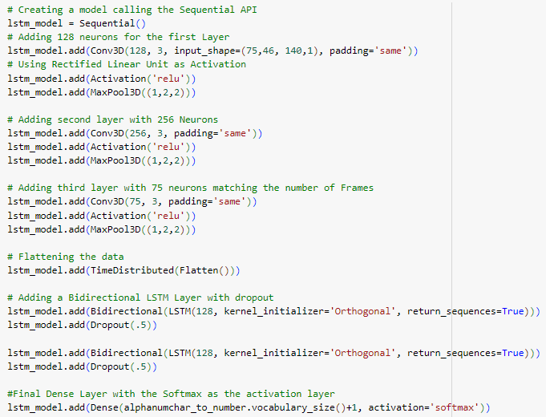
Passphrase Identification – Lip Reading Model
The video files were then scanned frame by frame and converted into Numpy arrays using CV2 library. The NumPy arrays for all frames were concatenated to form a combined array for each video file
A sample of 100 video files was used for training the models, and each video file, along with its alignment file, was converted into a NumPy array.
The dataset was split into Train and Test sets in the 80:20 ratio and converted into a tensor dataset before model building.
A Convolutional 3D Model with multiple hidden layers, each with 128, 256, and 75 neurons, was used, and ReLU was used as an activation function in these layers. The data was then flattened, and two more layers of Bidirectional LSTM were added to the model.
The final dense layer uses Softmax as an activation function and the maximum vocabulary size (40 in this model) as the number of classes
The performance was evaluated by testing the model on a few sample files in the dataset.

Slide 10
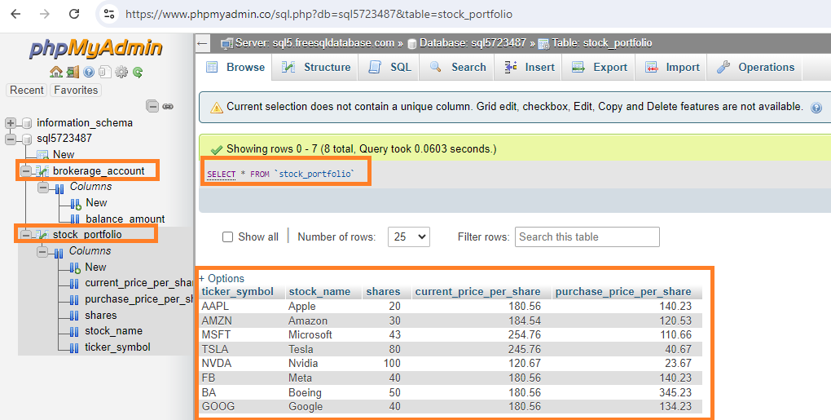
The Virtual Assistant- Loading the Data
After the customer is authenticated using voice recognition and Passphrase validation, they can access the Trading account and perform further transactions.
To make the trading experience more navigable, a virtual assistant was built so that the customer could ask questions about the Portfolio using simple English words.
Creating MySQL Database & Tables:
Two tables were created in this project, one containing the details about their stock portfolio and the other containing the balance amount
The model would return the results by fetching the data from the backend database.
Whisper Model to Extract Speech from Audio:
To provide capabilities for the customer to interact with the Virtual Assistant by asking questions instead of typing them manually, the model was also integrated with the Whisper Model.

Slide 11
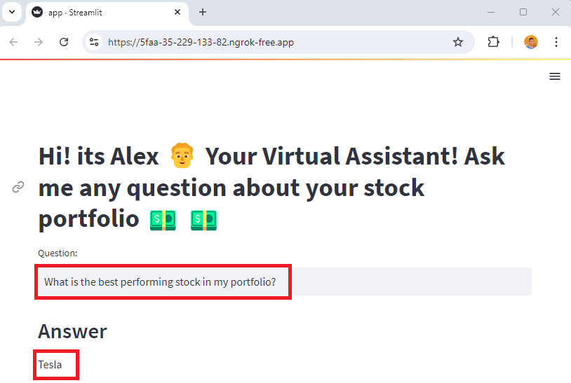
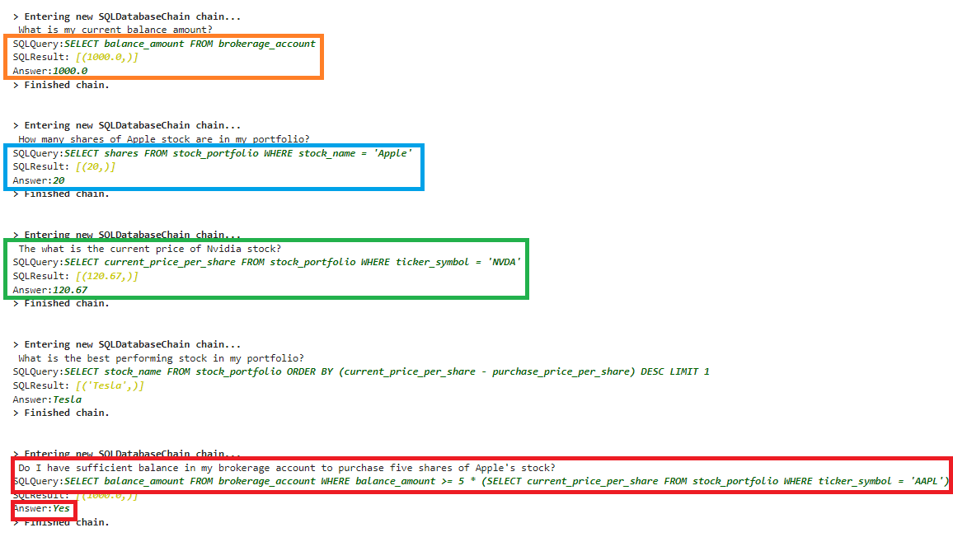
Building Virtual Assistant using LLM & Langchain
The Virtual Assistant was built using Google Palm, a Large Language Model from Google that uses Transformers and can perform various reasoning tasks such as common reasoning, explaining the code, etc.
Google Palm was integrated to work with the data from the online database using SQL Database Chain.
When the user asks questions about the Portfolio, such as "What is my Balance amount?“, the model converts the user question into SQL queries, executes them in the backend database, and returns the results.
To demonstrate the application, a sample Stream lit app was built to ask the app a sample question about the Portfolio, and the responses were recorded, as shown in the figure.

Slide 12
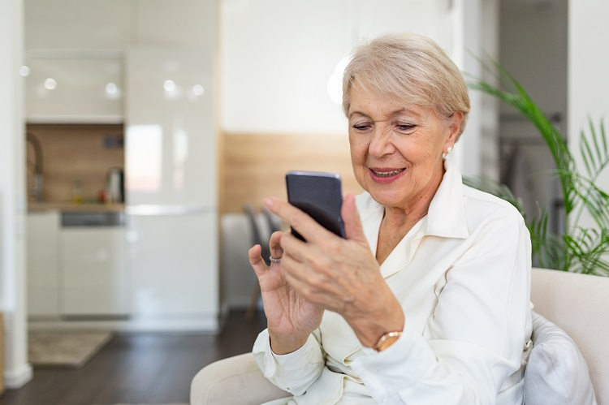
Implementation Plan & Recommendations
All the models must be trained on a large corpus to attain higher accuracy before production deployment. The Virtual Assistant model must be trained in a wide range of questions the customers can ask before deploying in Production.
The model does not include any retry capabilities, which are essential enhancements before deploying them in production.
The voice recognition model was trained with the voices of young male speakers. As the model is mainly intended for older adults and people with disabilities, it is recommended that the model be trained to use voices representing the general population.
The model was built for English-speaking customers. It is recommended that the model be expanded to other languages.

Slide 13
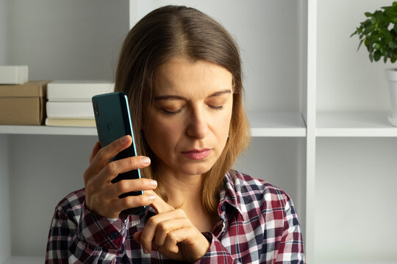
Limitations & Ethical Concerns
The project does not include a module to record the customer's voice to train the model. The models were trained using the data available on the internet.
The voice recognition can be easily exploited by bad actors and scammers.
Though the Project aims to provide an enhanced mobile trading and banking experience, it does not intend to entirely replace bankers or financial advisors in physical locations.
Older adults and people with disabilities are the most vulnerable parts of society in terms of financial exploitation. With the constant rise of online scams, banks and brokerages should implement more secure measures to protect their customers and alert and try to stop the scams before it is too late.

Slide 14

References
https://www.pewresearch.org/short-reads/2022/01/13/share-of-those-65-and-older-who-are-tech-users-has-grown-in-the-past-decade/
https://www2.deloitte.com/us/en/insights/industry/financial-services/accessible-banking-for-disabled.html
https://www.bankrate.com/banking/savings/savings-account-average-balance/#average-savings-by-age
https://www.raconteur.net/finance/banking-app-ages
https://www.knowledgehut.com/blog/web-development/long-short-term-memory

Slide 15

Thank You

